Slide 1
Support Vector Machine
-Gene selection using support vector machines with non-convex penalty
Reference: https://academic.oup.com/bioinformatics/article/22/1/88/218231

Slide 2
Background
One current difficulty in interpreting microarray data comes from their innate nature of ‘high-dimensional low sample size’. Take mice gene as an example, there are 40000+ genes while only 12 samples exist, meaning that there are 40000+ variables but only 12 observation. Successful gene selection will help to classify drinking behavior.
There is a regularization in support vector machines (SVMs) to identify important genes for classification. It is called the smoothly clipped absolute deviation penalty(SCAD), is imposed on the hinge loss function in the SVM. By systematically thresholding small estimates to zeros, the new procedure eliminates redundant genes automatically and yields a compact and accurate classifier.

Slide 3
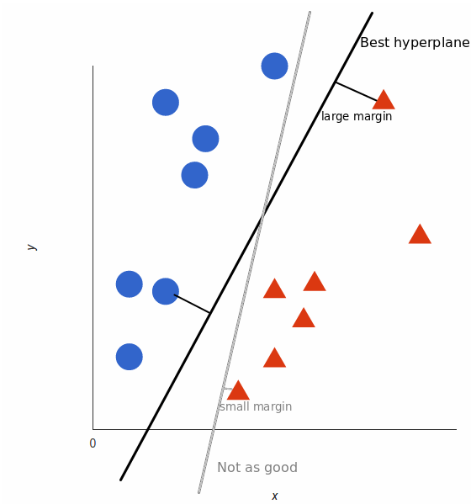
Support vector machine
A supervised binary classification machine learning model
It takes these data points and outputs the hyperplane (which in two dimensions it’s simply a line) that best separates different groups. This line is the decision boundary: anything that falls to one side of it we will classify as blue, and anything that falls to the other as red.
Hyperplane only depends on a few data points that are on the boundary. These points are called support vector. Therefore, it has demonstrated superior performances in classifying high-dimensional and low sample size data.
Picture from https://monkeylearn.com/blog/introduction-to-support-vector-machines-svm/#:~:text=A%20support%20vector%20machine%20(SVM,able%20to%20categorize%20new%20text.

Slide 4
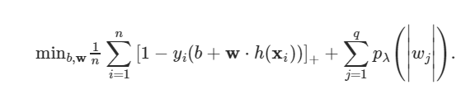
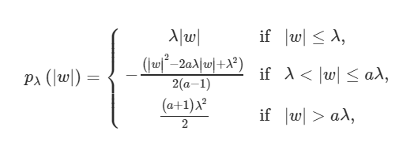
Support vector machine with SCAD
The SVM finds w and b within f(x) = b + w · h(x) by minimizing
Penalty
Regularization requires
penalty term < threshold
Small coefficient w will be suppressed to 0. Large coefficient w will be less suppressed. If coefficient is large enough (>aλ), it will not be suppressed.
Variables with coefficient w = 0 will be filtered out.

Slide 5
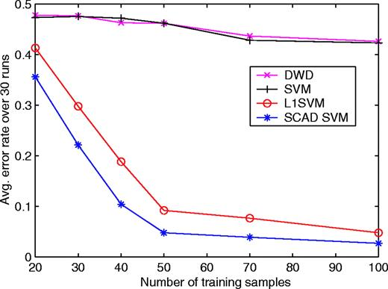
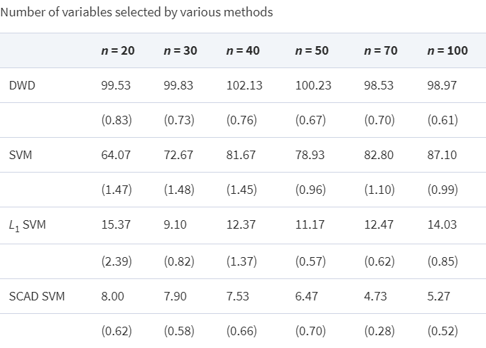
Support vector machine with SCAD - Performance
Experiment: 200 variables in the dataset, only 2 of them are important

Slide 6
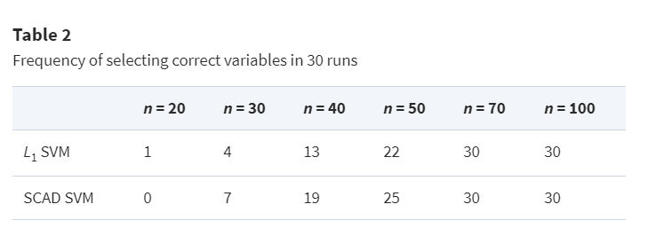
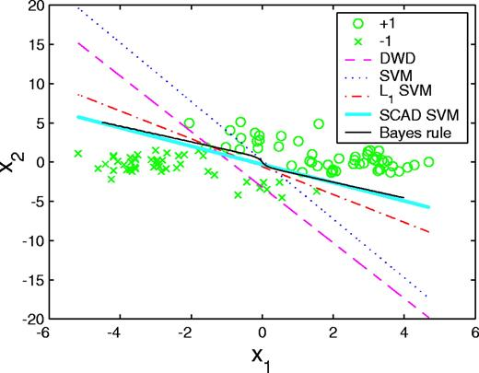
Support vector machine with SCAD - Performance
Dataset: 100 observations with 2 variables selected by SCAD SVM

Slide 7
Apply to mice data (drinker vs non-drinker)!
Step 1: Start with Wilcoxon test reduce 40000+ variables to 3779 variables.
Step 2: Apply SCAD SVM to 3779 variables in R using package “penaltySVM”.
(Reference: https://cran.r-project.org/web/packages/penalizedSVM/penalizedSVM.pdf)
8 mice are used in the model fitting - support vectors. (Mice 3, 4, 5, 6, 7, 8, 10, 11)
Algorithm selects 34 out of 3779 variables.
All 12 mice have been predicted correctly.
Step 3: Apply random forest to the 34 variables. 14 - 28 variables have importance measurement > 0, depends on number of trees are built.

